Slide 1
2016-CS-122 2016-CS-109
Numerical Methods for Partial differential equations

Slide 2
Agenda
Numerical Techniques for Solving PDE
Implementation, Scope and Importance of Numerical Methods
Comparison of Different Methods

Slide 3
Problem Statement
In Real world, there are many mathematical problems that cannot be solved analytically. Calculations are difficult and time consuming on each step. So, Numerical Methods provide us a Numerical approximation to that problem. These methods are useful because approximations can be made easily by using a computational machine.

Slide 4
Methodology
There are two methods we discussed so far for solving Partial differential equations
Finite Difference Method
Forward Euler method (or Explicit Method)
Forward Euler method (or Implicit Method)
Crank–Nicolson method
Finite Element Method
Galerkin method

Slide 5
Finite Difference Method
The core idea of the finite-difference method is to replace continuous derivatives with so-called difference formulas that involve only the discrete values associated with positions on the mesh

Slide 6
Finite Element Method
Finite Element Method techniques include
Dividing the domain of the problem into a collection of subdomains, with each subdomain represented by a set of element equations to the original problem
systematically recombining all sets of element equations into a global system of equations for the final calculation. The global system of equations has known solution techniques, and can be calculated from the initial values of the original problem to obtain a numerical answer.

Slide 7
Comparison Table
Property | Finite Difference Method | Finite Element Method
CALCULATIONS | Small amount of calculations in each step | Large amount of calculations in each step
MEMORY REQUIREMENT | No large memory requirement so no large matrices are formed | Large memory requirement for storage of stiffness matrices
ACCURACY | Requires more calculations and memory but highly accurate | Requires less calculations and memory but relatively low accuracy
DISCRETIZATION CRITERIA | Discretization is based upon the differential form of the PDE to be solved. Each derivative is replaced with an approximate difference formula | Discretization is based upon a piecewise representation of the solution in terms of specified basis functions.

Slide 8



Error Analysis
Errors depend on mesh spacing and time step
Consider a Taylor series expansion φ(x) about the point xi
Solve for (∂φ/∂x)xi
The term on the right hand side of above Equation is called the truncation error of the finite difference approximation. The “big O” notation can be used to express the dependence of the truncation error on the mesh spacing.

Slide 9
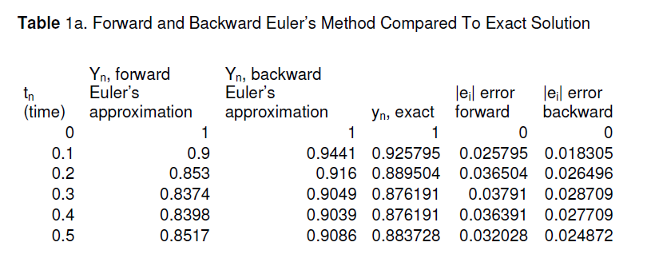
Results

Slide 10
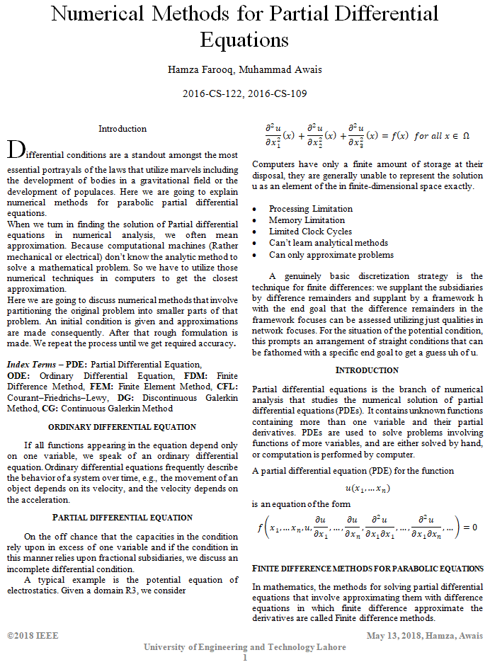
Report Demo

Slide 11
Any Questions?

